Slide 1
Exercise
Script files
Function files

Slide 2
Exercise:1
Write a program to find Total No of items, Total cost of items & Average cost of items where
Articles Nos Cost/item
Eraser 4 25
Pad 6 52
Tape 2 99

Slide 3
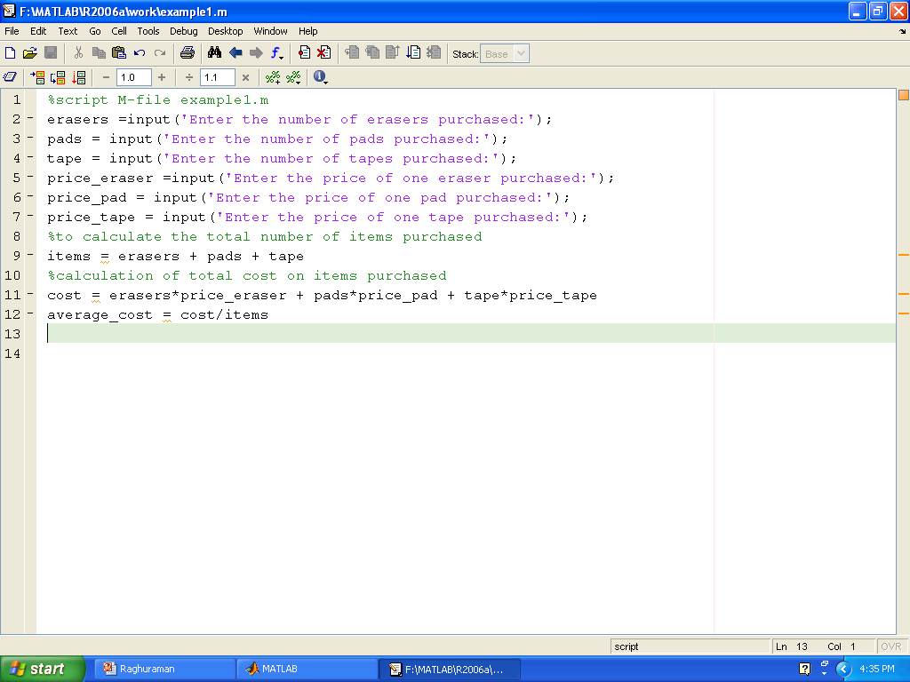
Ex:1

Slide 4
Exercise:2
Write a program to find the Distance between two points given (4,5)&(10,12)

Slide 5
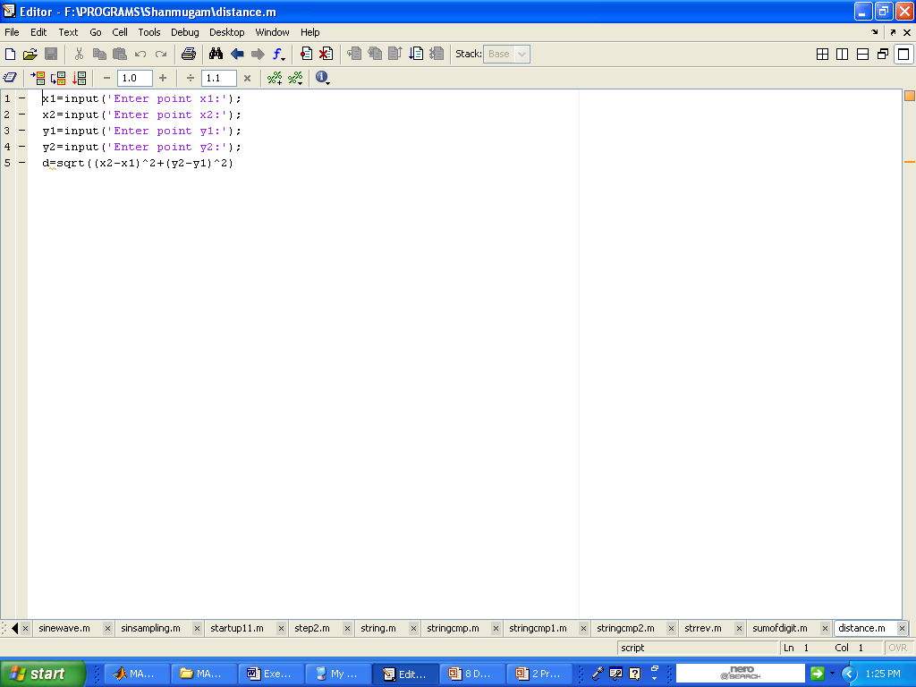
Ex:2

Slide 6
Exercise:3
Write a program to find the given string is palindrome or not. (reverse the given string and compare this with given string if they are equal display, ‘the given string is palindrome else, display ‘the given string is not palindrome)

Slide 7
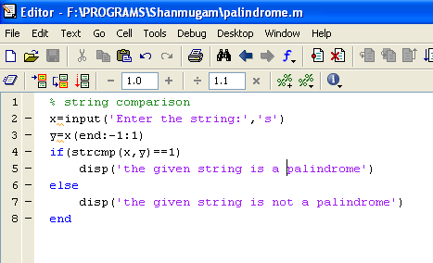
Ex:3

Slide 8
Exercise:4
The volume of sphere is given by V=4*pi*r^3/3, where r is the radius. Use matlab to compute the radius of a sphere having a volume 30 percent greater than that of a sphere of radius 5 ft.
(1 ft=.3048m)

Slide 9
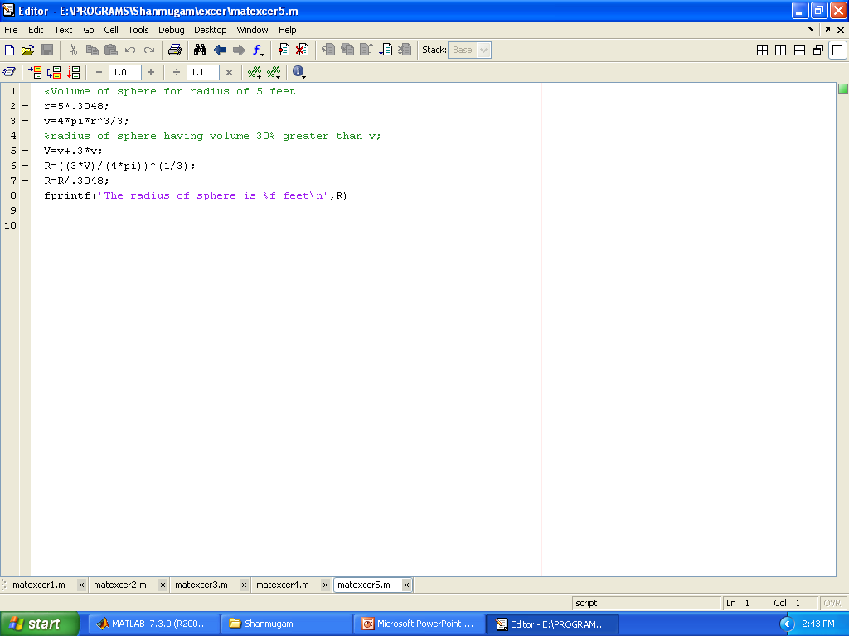
Ex:4

Slide 10
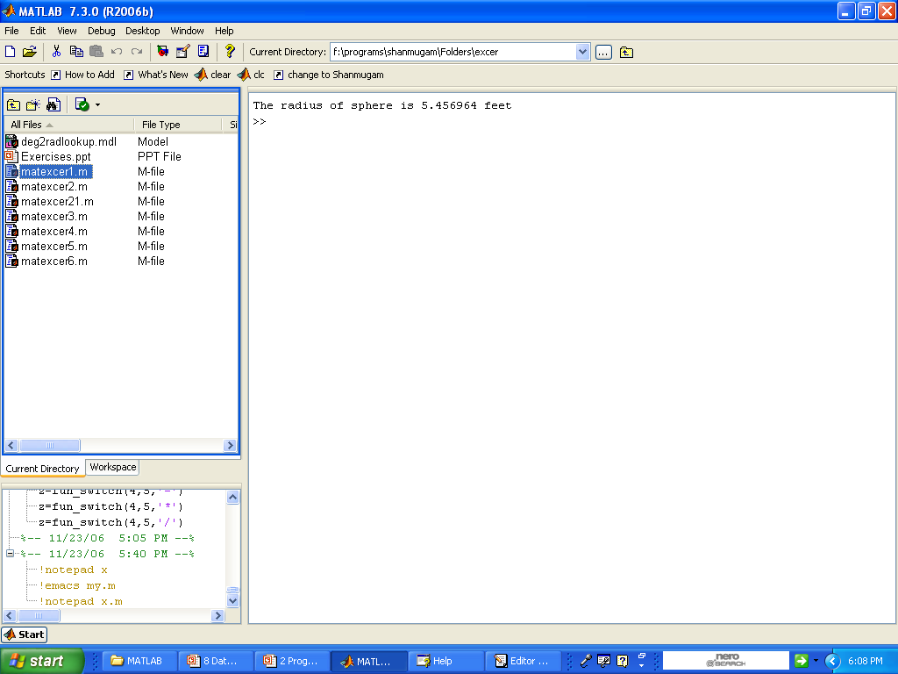
Result

Slide 11
Exercise:5
Generate a table of conversions from degree to radians. The first line should contain the values for 0 deg and next line should contain values for 10 deg and so on. The last line should contain the value 360 deg. recall( pi=180deg)

Slide 12
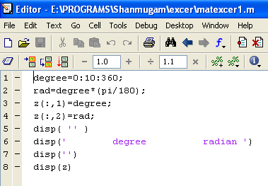
Ex:5

Slide 13
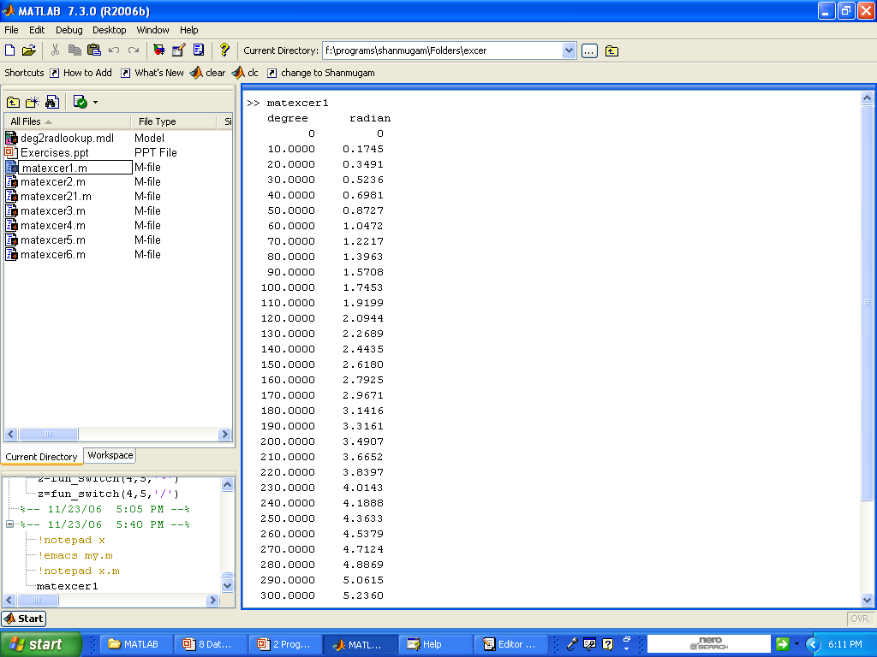
Result

Slide 14
Exercise:
Write a function file ‘sinusoid (A,t,f)’ to plot a sine wave, given the amplitude, time & frequency

Slide 15
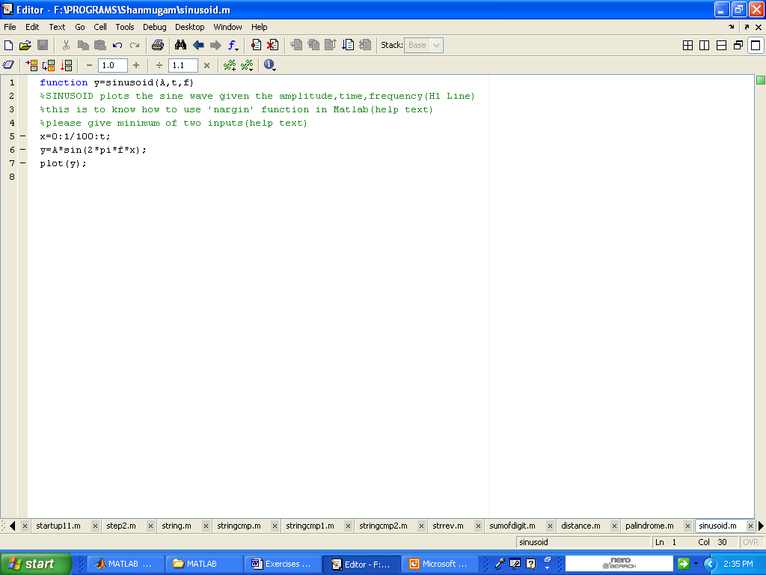

Slide 16
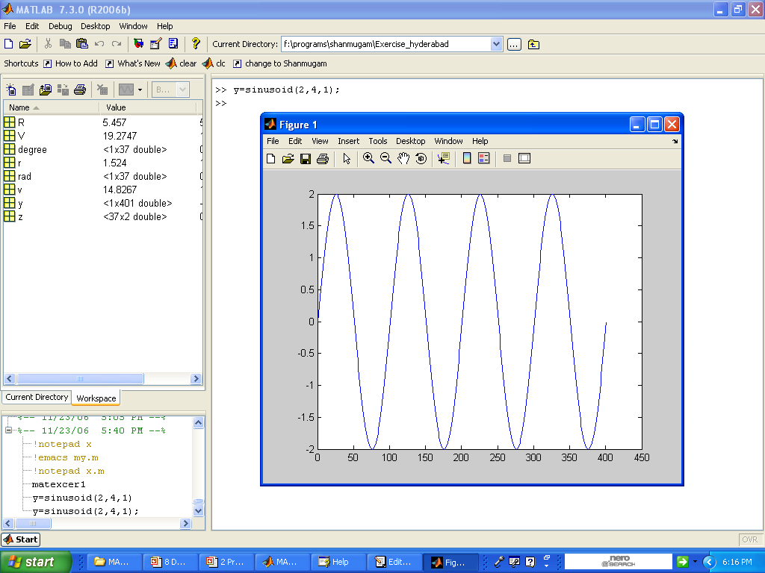
Result

Slide 17
Exercise:
Write a program ‘circle (r)’ to plot the circle of radius r;

Slide 18
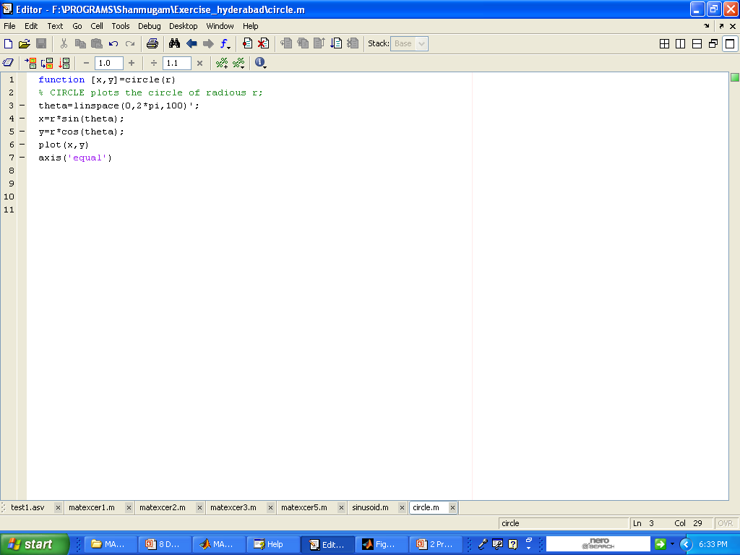
Ex:

Slide 19
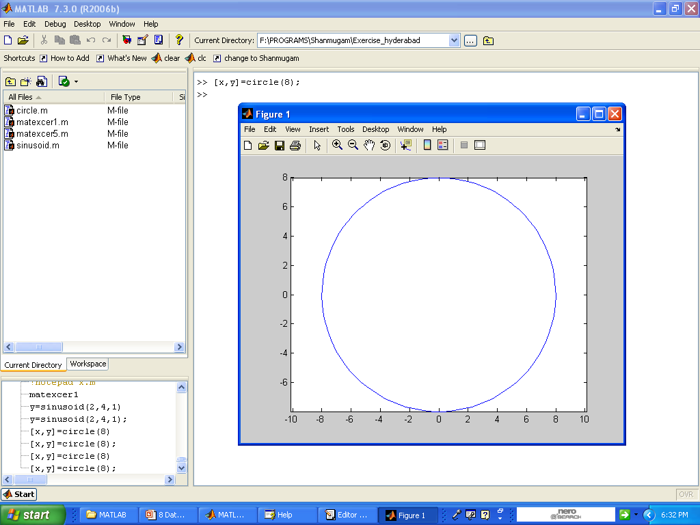
Result

